Slide 1


#WestisBest
#Innovation2021
#HackforGood
#HackforGrowth
#Hackathon2021
#WomenInTech

Slide 2
Data Onboarding Accelerator
Steve Moss & Ashutosh Sharma
Reviewer/Coach: Pradeep Ramadasan

Slide 3
The Data Onboarding Accelerator enables our customers to easily profile and understand vast amounts of data using a single Azure Databricks notebook.
Profiles leverages Analyzers to analyze each column of a dataset.
A large percent of Data Analyst’s and Data Scientist’s time is spent understanding and cleaning data.
Reducing this would be a win-win of increased innovation & value to our customers and ultimately increased ACR.
Note that Azure Databricks and/or Azure Synapse don’t have a built-in comprehensive solution.
Notes:
-

Slide 4
The Problem in Numbers
15
83%
% CEO’s concerned about the quality of data their decisions based on (Forbes)
50-80%
Est % additional Revenue of Companies that concentrate on Data Quality.
Percentage of Data Scientists time spent collecting and preparing data.

Slide 5
What Solution do we have for this problem?
Easy to configure Azure Databricks notebook using open source PyDeequ library
designed to scale to billions of rows
Library originally developed and used by aws for their SageMaker and Glue profiling
Will profile big-data in ADLS of multiple files in parquet or csv format
Gives suggested constraints for the data
Unit Tests of Constraints
Output detailed profiling information.
To allow to keep the data clean and detect issues.
To confirm that the data quality is maintained and tested.

Slide 6
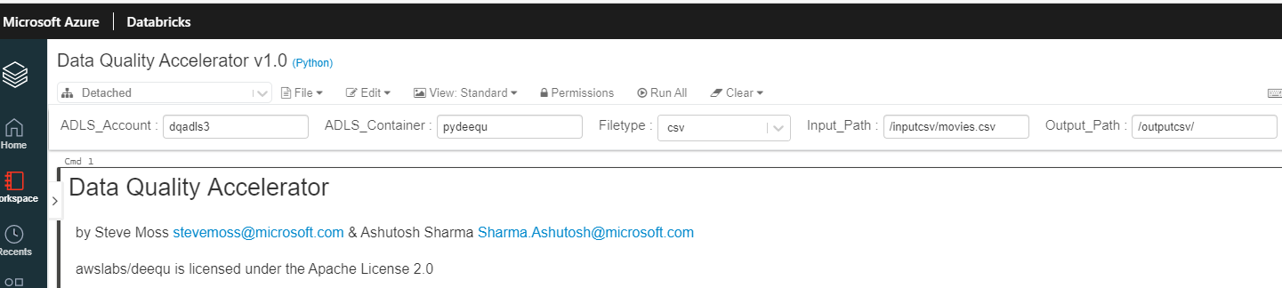
How Is The Solution Implemented/Used? Inputs
Azure Databricks Notebook using pydeequ libraries
Input: ADLS Account, Container, Filetype, Input Path, Output Path
Don’t need to know the format of the data or columns names!

Slide 7
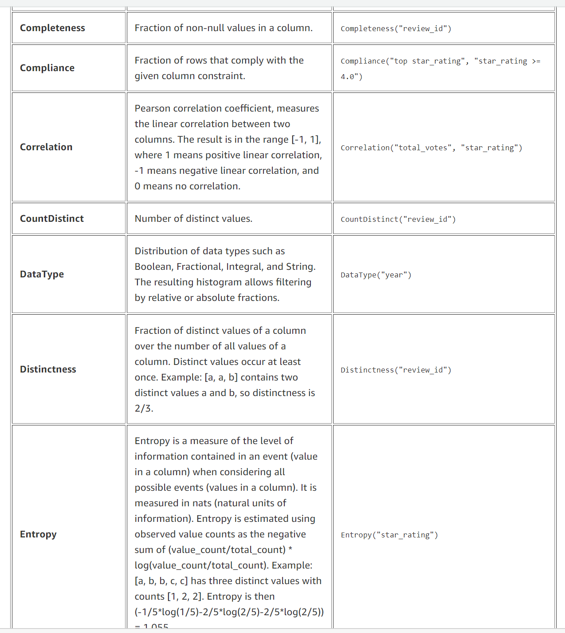
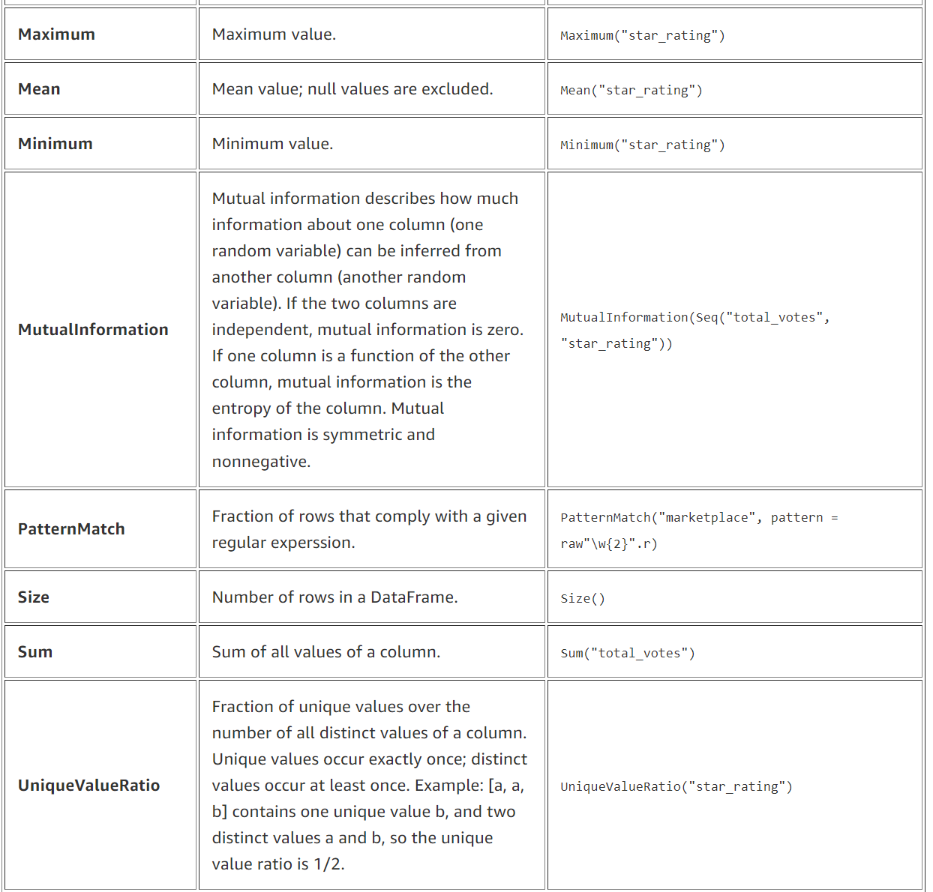
Examples of profiling metrics

Slide 8
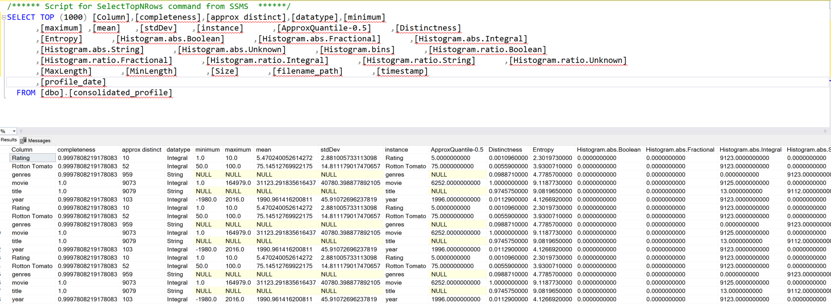
What are the Outputs
File or database with detailed profile data
& Suggestions of Constraints to keep DataClean

Slide 9
Entropy
Entropy is a measure of the level of information contained in an event when considering all possible events
Entropy on single column, multi column and entire dataset
Cumulative Entropy, Joint Entropy, Maximum Entropy etc
Data Quality using Entropy
Track Entropy to identify anomalies in data e.g. sex not in (M,F)
Functional dependency of a column on another one, if entropy is >0; 0 if independent

Slide 10
Future Enhancements: Phase 2
Future steps:
Implement Configurable Constraint Unit Tests
Implement Repository for Anomaly Detection/Data Drift
Implement on Synapse Serverless Spark
Visualization
CDM integration: write pre-built scripts to determine if data is compatible with CDM model

Slide 11
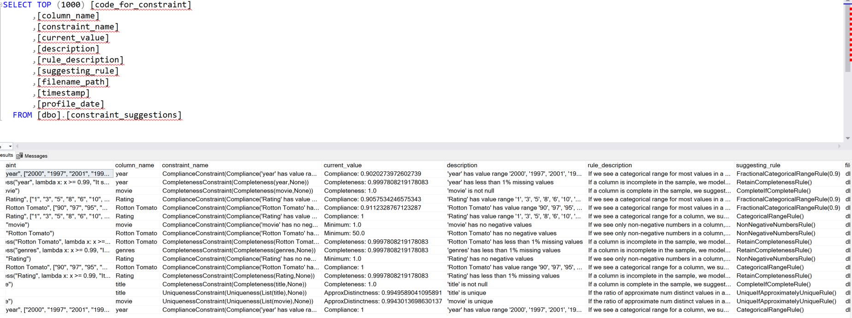
How Is The Solution Implemented/Used? Outputs (cont’d)
2) Suggestions of Constraints to enforce Data Quality

Slide 12
Appendix

Slide 13
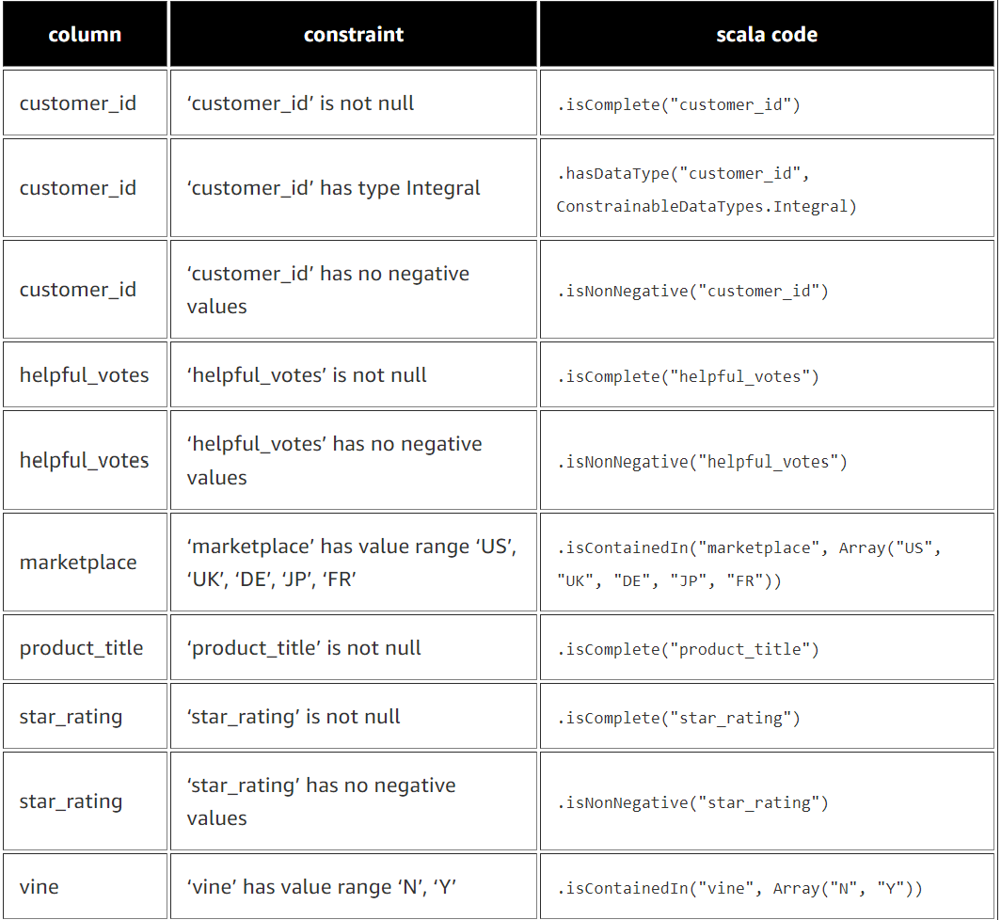
Constraint automated suggestions example

Slide 14
What is Deequ?
Deequ is an Apache 2.0 opensource licensed spark library/tool
Deequ allows you to calculate data quality metrics on your dataset, define and verify data quality constraints, and be informed about changes in the data distribution. Instead of implementing checks and verification algorithms on your own, you can focus on describing how your data should look. Deequ supports you by suggesting checks for you. Deequ is implemented on top of Apache Spark and is designed to scale with large datasets (think billions of rows) that typically live in a distributed filesystem or a data warehouse.
It was developed by AWS and their name is on the Apache license and is used internally there…

Slide 15
References
Overview
Test data quality at scale with Deequ | AWS Big Data Blog (amazon.com)
Github (original Scala version)
awslabs/deequ: Deequ is a library built on top of Apache Spark for defining "unit tests for data", which measure data quality in large datasets. (github.com)
Github: (python usage fork
pydeequ · PyPI
Research paper on concepts used:
p1781-schelter.pdf (vldb.org)
The 5 Key Reasons Why Data Quality Is So Important (cerasis.com)
Deloitte BrandVoice: Leading The Enlightened Workforce In The Next Normal (forbes.com)
How Poor Data Quality Negatively Impact Your Business - The Daily MBA

